Slide 1
Speedrunning Super Mario Bros.
By: Phillip Nissen

Slide 2

Introduction
Super Mario Bros. was released in April 1983 by Nintendo for the Nintendo Entertainment System.
Almost 40 years ago: why would people still play it?
Speedrunning is attempting to complete a game as quickly as possible.
I will cover any%, meaning you can complete any percentage of the game to beat it.
This will be a basic overview.

Slide 3
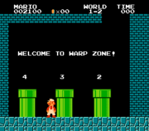
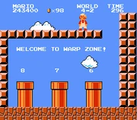
Level Structure
8 worlds containing 4 levels each, for a total of 32 levels.
Warp Zones in worlds 1 and 4.
Play 1-1, 1-2, warp to 4-1, 4-1, 4-2, warp to world 8, and play 8-1, 8-2, 8-3, and 8-4.

Slide 4

1-1
The fastest way through most levels is running.
General strategy is to accelerate to running speed quickly, and maintain it as long as possible.
1-1 contains a pipe leading to a sub-area which saves time.

Slide 5
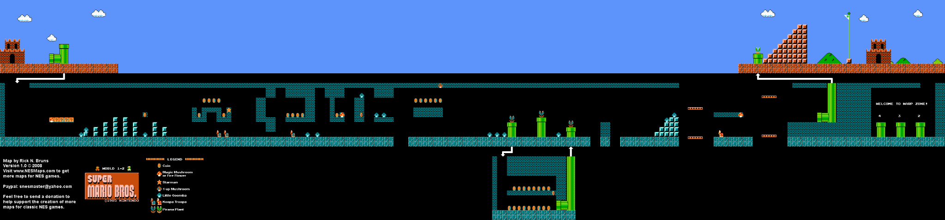
1-2
Run through the level
Go above the pipe at the end to get to the warp zone and world 4

Slide 6
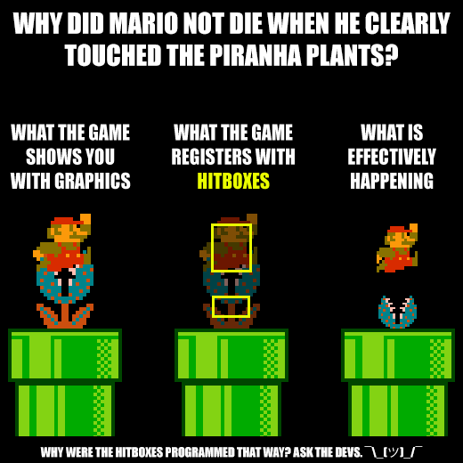

4-1
Hold right and jump occasionally
Easiest level due to piranha plant hitboxes

Slide 7
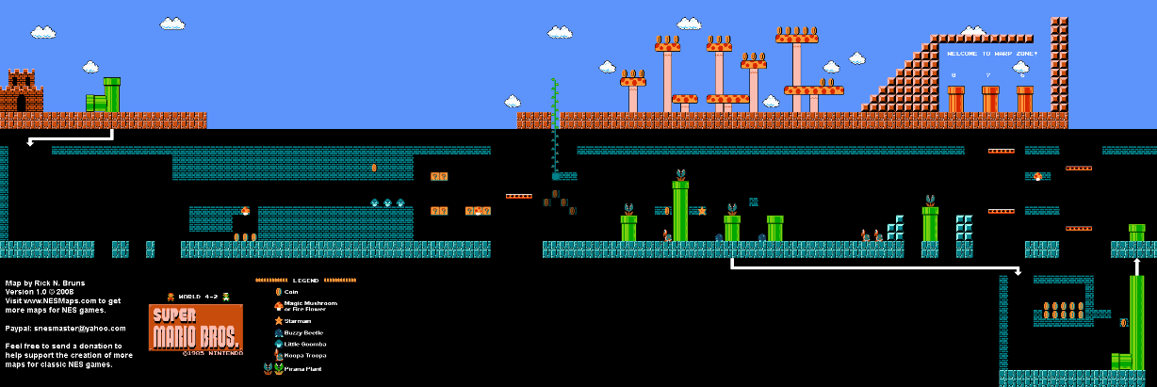
4-2
Normally take a vine to the warp zone
Where pipes go is based on screen scroll; can scroll the screen left to make the pipe lead to the warp zone

Slide 8

Wrong Warp Comparison
Normal Route
Wrong Warp

Slide 9
8-1
Longest level in the game
Mainly a matter of jumping at the right time and keep moving right
Difficult execution, not very interesting theoretically

Slide 10

8-2
Similar to 8-1: Hold right and jump.
Difficult execution, not really any tricks

Slide 11
8-3
Hardest level in the game: Hammer Bros!
Throw hammers in an arc which can interrupt Mario’s jump
Six places where Hammer Bros can be doing random activities

Slide 12
8-4
Final level; laid out like maze
Same every time
Small wrong warp
Hitting the axe behind Bowser kills him and ends the run

Slide 13
Conclusion
Super Mario Bros was released almost 40 years ago and people still play it to this day.
Speedrunners play through the game quickly using strategies outlined and many more.
If you’re making a game and want it to last a long time, consider making it interesting to speedrun.

Slide 14
References
Maps: https://nesmaps.com
Piranha Plant Hitbox: https://www.reddit.com/r/speedrun/comments/9n2dtw/if_the_piranha_plants_looked_as_small_as_their/

